Slide 1
SQL JOINS

Slide 2
RECAP
Set Operations
String functions
Date and Time functions

Slide 3
Joins
MySQL JOIN is a fundamental feature that combines rows from two or more tables based on a related column between them.
SQL uses joins to combine tables horizontally.
This produces results that can be compared to a DATA step merge.
It allows for efficient data retrieval by enabling the extraction of related information from multiple tables in a single query.
Table A Table B

Slide 4
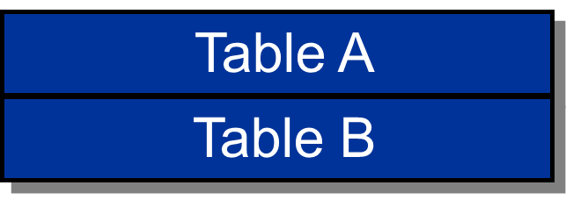
Why joins instead of Set operations?
we use set operations on same schema relations.
Set operations like union , intersect and except are used on 2 tables with same fields.
SQL uses set operators to combine tables vertically.
This produces results that can be compared to a DATA step concatenation.
No INTERSECT or EXCEPT in MySQL natively does not support

Slide 5
Joins Vs Set
Feature | Joins | Set Operations
Combination | Horizontal (side-by-side) | Vertical (top to bottom)
Result Structure | Combines columns from different tables | Combines rows from different queries
Purpose | Retrieving related data from tables | Combining results of multiple queries
Example | Combining employee and department data | Combining lists of students from different years

Slide 6
MySQL JOIN
A MySQL JOIN is a method to combine data from two or more tables in a database based on a related column between them.
JOINs allow us to retrieve related data from multiple tables in a single query, avoiding the need for numerous separate queries.
JOINs help maintain referential integrity by ensuring that relationships between tables are respected and data consistency is preserved.
By allowing the use of normalized database structures (where data is split into different tables to reduce redundancy), JOINs help in efficiently managing and organizing data.
JOINs are often used in conjunction with GROUP BY and aggregation functions (like COUNT, SUM, AVG) to perform comprehensive data analysis.

Slide 7
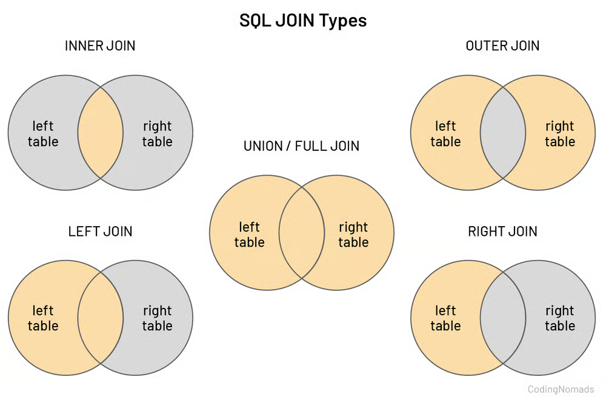
Types of Joins

Slide 8
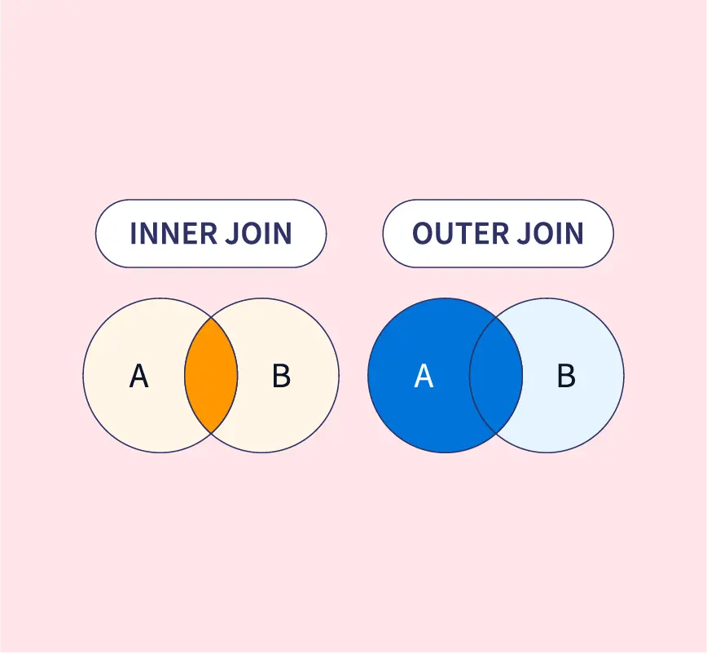
Types of Joins
SQL supports two types of joins:
  Inner joins
  Outer joins
.

Slide 9
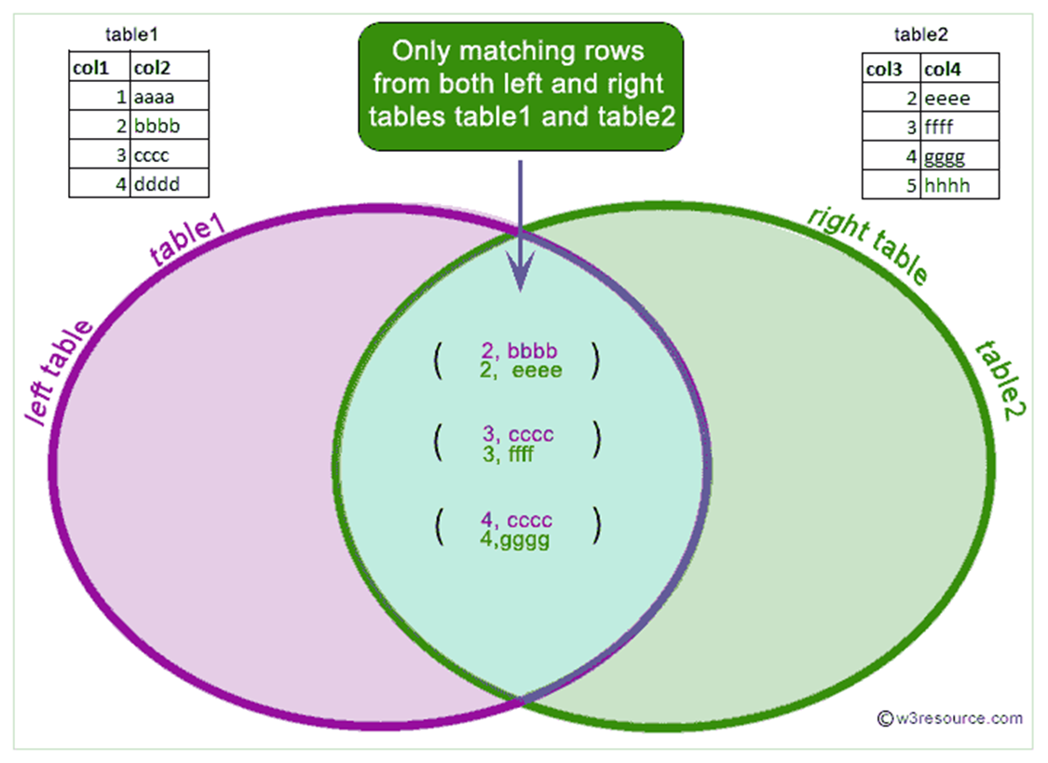
Inner joins
It Returns records that have matching values in both tables.
Enable a maximum of 256 tables to be joined
at the same time

Slide 10
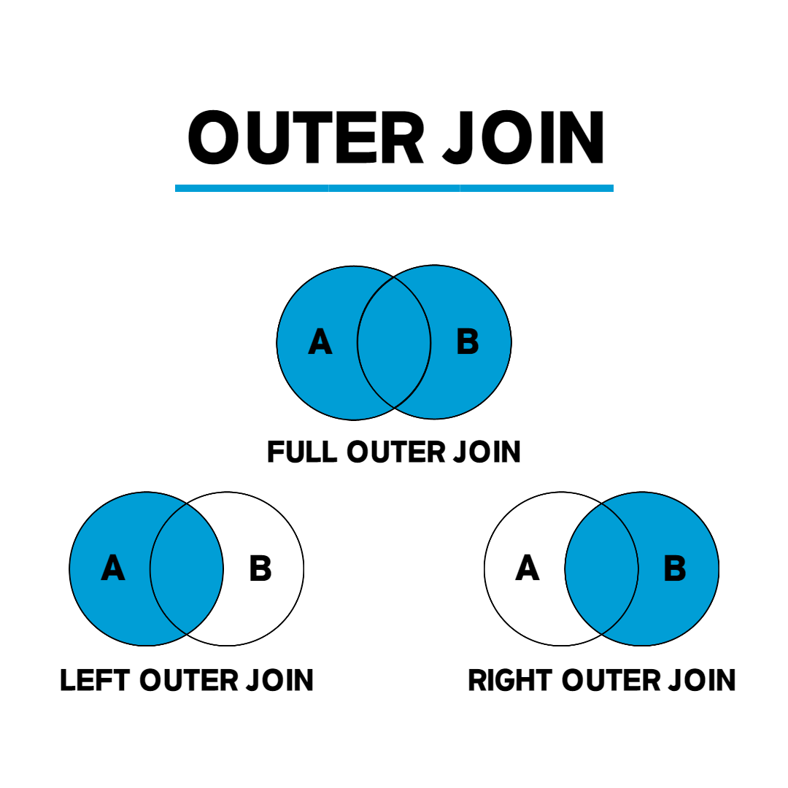
Outer Join
Return all matching rows, plus nonmatching rows
from one or both tables
Can be performed on only two tables or views
at a time.

Slide 11
Cartesian Product
A Cartesian product is generated when you combine every row from one table with every row from another table.
A query that lists multiple tables in the FROM clause without a WHERE clause produces all possible combinations of rows from all tables. This result is called the Cartesian product.
select *
from one, two;

Slide 12
Cartesian Product
Table Two
X | B
2 | x
3 | y
5 | v
Table One
X | A
1 | a
4 | d
2 | b

Slide 13
Cartesian Product
Table One
X | A
1 | a
4 | d
2 | b
Table Two
X | B
2 | x
3 | y
5 | v
Result Set
X | A | X | B
1 | a | 2 | x

Slide 14
Cartesian Product
Table One
X | A
1 | a
4 | d
2 | b
Table Two
X | B
2 | x
3 | y
5 | v
Result Set
X | A | X | B
1 | a | 2 | x
1 | a | 3 | y

Slide 15
Cartesian Product
Table One
X | A
1 | a
4 | d
2 | b
Table Two
X | B
2 | x
3 | y
5 | v
Result Set
X | A | X | B
1 | a | 2 | x
1 | a | 3 | y
1 | a | 5 | v

Slide 16
Cartesian Product
Table One
X | A
1 | a
4 | d
2 | b
Table Two
X | B
2 | x
3 | y
5 | v
Result Set
X | A | X | B
1 | a | 2 | x
1 | a | 3 | y
1 | a | 5 | v
4 | d | 2 | x

Slide 17
Cartesian Product
Table One
X | A
1 | a
4 | d
2 | b
Table Two
X | B
2 | x
3 | y
5 | v
Result Set
X | A | X | B
1 | a | 2 | x
1 | a | 3 | y
1 | a | 5 | v
4 | d | 2 | x
4 | d | 3 | y

Slide 18
Cartesian Product
Table One
X | A
1 | a
4 | d
2 | b
Table Two
X | B
2 | x
3 | y
5 | v
Result Set
X | A | X | B
1 | a | 2 | x
1 | a | 3 | y
1 | a | 5 | v
4 | d | 2 | x
4 | d | 3 | y
4 | d | 5 | v

Slide 19
Cartesian Product
Table One
X | A
1 | a
4 | d
2 | b
Table Two
X | B
2 | x
3 | y
5 | v
Result Set
X | A | X | B
1 | a | 2 | x
1 | a | 3 | y
1 | a | 5 | v
4 | d | 2 | x
4 | d | 3 | y
4 | d | 5 | v
2 | b | 2 | x

Slide 20
Cartesian Product
Table One
X | A
1 | a
4 | d
2 | b
Table Two
X | B
2 | x
3 | y
5 | v
Result Set
X | A | X | B
1 | a | 2 | x
1 | a | 3 | y
1 | a | 5 | v
4 | d | 2 | x
4 | d | 3 | y
4 | d | 5 | v
2 | b | 2 | x
2 | b | 3 | y

Slide 21
Cartesian Product
Table One
X | A
1 | a
4 | d
2 | b
Table Two
X | B
2 | x
3 | y
5 | v
Result Set
X | A | X | B
1 | a | 2 | x
1 | a | 3 | y
1 | a | 5 | v
4 | d | 2 | x
4 | d | 3 | y
4 | d | 5 | v
2 | b | 2 | x
2 | b | 3 | y
2 | b | 5 | v

Slide 22
Cartesian Product
Table One
X | A
1 | a
4 | d
2 | b
Table Two
X | B
2 | x
3 | y
5 | v
3 rows
Result Set
X | A | X | B
1 | a | 2 | x
1 | a | 3 | y
1 | a | 5 | v
4 | d | 2 | x
4 | d | 3 | y
4 | d | 5 | v
2 | b | 2 | x
2 | b | 3 | y
2 | b | 5 | v

Slide 23
Cartesian Product
Table One
X | A
1 | a
4 | d
2 | b
Table Two
X | B
2 | x
3 | y
5 | v
3 rows
3 rows
Result Set
X | A | X | B
1 | a | 2 | x
1 | a | 3 | y
1 | a | 5 | v
4 | d | 2 | x
4 | d | 3 | y
4 | d | 5 | v
2 | b | 2 | x
2 | b | 3 | y
2 | b | 5 | v

Slide 24
Cartesian Product
Table One
X | A
1 | a
4 | d
2 | b
Table Two
X | B
2 | x
3 | y
5 | v
3 rows
X
3 rows
Result Set
X | A | X | B
1 | a | 2 | x
1 | a | 3 | y
1 | a | 5 | v
4 | d | 2 | x
4 | d | 3 | y
4 | d | 5 | v
2 | b | 2 | x
2 | b | 3 | y
2 | b | 5 | v
9 rows

Slide 25
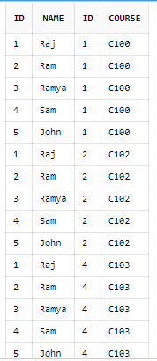
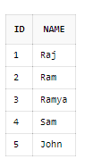

Cartesian product
select * from instructor, teaches;
INSTRUCTOR
TEACHES

Slide 26
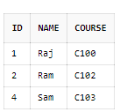
CARTESIAN PRODUCT
select instructor.id, instructor.name, teaches.course from instructors,teaches WHERE instructor.id=teaches.id;
INSTRUCTOR
TEACHES

Slide 27
Natural Join Vs Inner Join
A Natural Join is where 2 tables are joined on the basis of all common columns.
A Inner Join is where 2 tables are joined on the basis of common columns mentioned in the ON clause.

Slide 28


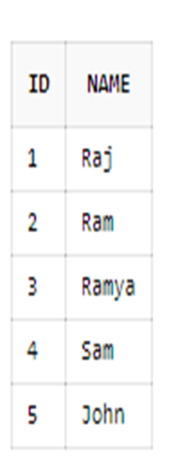
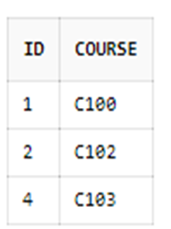
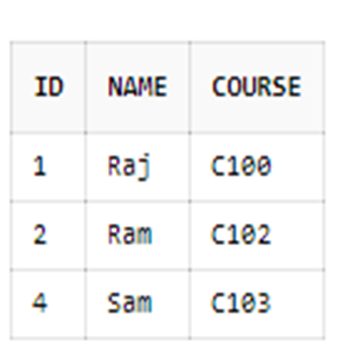
Natural join
select * from instructors natural join teaches;

Slide 29
Inner Joins
Inner join syntax resembles Cartesian product syntax, but a WHERE clause restricts which rows are returned.
General form of an inner join:
SELECT column-1<, …column-n>
FROM table-1|view-1<, … table-n|view-n>
WHERE join-condition(s)
<AND other subsetting conditions>
<other clauses>;

Slide 30
Inner Join Alternate Syntax
An inner join can also be accomplished using an alternate syntax, which limits the join to a maximum of two tables.
General form of an inner join:
SELECT column-1 <, …column-n>
FROM table-1
INNER JOIN
table-2
ON join-condition(s)
<other clauses>;
This syntax is common in SQL code produced by code generators such as SAS Enterprise Guide.
The ON clause specifies the JOIN criteria;
WHERE clause can be added to subset the results.

Slide 31
Inner Joins
Conceptually, when processing an inner join, SQL does the following:
  Builds the Cartesian product of all the tables listed
  Applies the WHERE clause to limit the rows returned

Slide 32
Inner Joins: Cartesian Product Built
Table One
X | A
1 | a
4 | d
2 | b
Table Two
X | B
2 | x
3 | y
5 | v
select *
from one, two
X | A | X | B
1 | a | 2 | x
1 | a | 3 | y
1 | a | 5 | v
4 | d | 2 | x
4 | d | 3 | y
4 | d | 5 | v
2 | b | 2 | x
2 | b | 3 | y
2 | b | 5 | v
Notes:
s105d02

Slide 33
Inner Joins: WHERE Clause Restricts Rows
Table One
X | A
1 | a
4 | d
2 | b
Table Two
X | B
2 | x
3 | y
5 | v
select *
from one, two
where one.x=two.x;
X | A | X | B
1 | a | 2 | x
1 | a | 3 | y
1 | a | 5 | v
4 | d | 2 | x
4 | d | 3 | y
4 | d | 5 | v
2 | b | 2 | x
2 | b | 3 | y
2 | b | 5 | v
Notes:
s105d02

Slide 34
Inner Joins: Results Are Returned
Table One
X | A
1 | a
4 | d
2 | b
Table Two
X | B
2 | x
3 | y
5 | v
select *
from one, two
where one.x=two.x;
X | A | X | B
2 | b | 2 | x
 Tables do not have to be sorted before they are joined.
Notes:
s105d02

Slide 35
Inner Joins
One method of displaying the X column only once is to use a table qualifier in the SELECT list.
Table One
X | A
1 | a
4 | d
2 | b
Table Two
X | B
2 | x
3 | y
5 | v
select one.x, a, b
from one, two
where one.x=two.x;
X | A | B
2 | b | x
Notes:
s105d03

Slide 36
INNER JOIN
INSTRUCTOR
select instructor.id, instructor.name, teaches.course from instructors,teaches WHERE instructor.id=teaches.id;
TEACHES

Slide 37
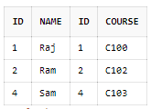
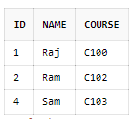
INNER JOIN
select * from instructor inner join teaches on instructor.id=teaches.id
INSTRUCTOR
TEACHES
Select instructor.id, instructor.name, teaches.course from instructor inner join teaches on instructor.id=teaches.id
(or)
Select * from instructor natural inner join teaches;

Slide 38
Outer Joins
Inner joins returned only matching rows.
When you join tables, you might want to include nonmatching rows as well as matching rows.

Slide 39
Outer Joins
You can retrieve both nonmatching and matching rows using an outer join.
Outer joins include left, full, and right outer joins. Outer joins can process only two tables at a time.
Full
Left
Right

Slide 40
Outer Joins
Outer join syntax is similar to the inner join alternate syntax.
General form of an outer join:
The ON clause specifies the join criteria in outer joins.
SELECT column-1 <, …column-n>
FROM table-1
LEFT|RIGHT|FULL JOIN
table-2
ON join-condition(s)
<other clauses>;

Slide 41
Full outer join
SELECT * FROM table1 LEFT JOIN table2 ON table1.common_column = table2.common_column UNION SELECT * FROM table1 RIGHT JOIN table2 ON table1.common_column = table2.common_column;

Slide 42
Determining Left and Right
Consider the position of the tables in the FROM clause.
  Left joins include all rows from the first (left) table, even if there are no matching rows in the second (right) table.
  Right joins include all rows from the second (right) table, even if there are no matching rows in the first (left) table.
  Full joins include all rows from both tables, even if there are no matching rows in either table.
Left table
Right table
FROM table-1 join-type table-2
ON join-condition(s);

Slide 43
Left Join
Table One
X | A
1 | a
4 | d
2 | b
Table Two
X | B
2 | x
3 | y
5 | v
select *
from one left join two
on one.x = two.x;
X | A | X | B
1 | a | .
2 | b | 2 | x
4 | d | .
Notes:
s105d07

Slide 44
Right Join
Table Two
X | B
2 | x
3 | y
5 | v
Table One
X | A
1 | a
4 | d
2 | b
select *
from two right join one
on one.x = two.x;
X | B | X | A
. |  | 1 | a
2 | x | 2 | b
. |  | 4 | d
Notes:
s105d08

Slide 45
Full Join
Table One
X | A
1 | a
4 | d
2 | b
Table Two
X | B
2 | x
3 | y
5 | v
select *
from one full join two
on one.x = two.x;
X | A | X | B
1 | a | .
2 | b | 2 | x
. |  | 3 | y
4 | d | .
. |  | 5 | v
Notes:
s105d09

Slide 46
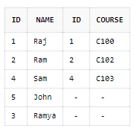
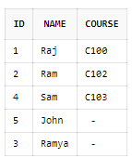
LEFT JOIN
select * from instructor left join teaches on instructor.id=teaches.id
INSTRUCTOR
TEACHES
select instructor.id, instructor.name, teaches.course from instructor left outer join teaches on instructor.id=teaches.id
(or)
select * from instructor natural left join teaches;

Slide 47
In the previous slide replace the keyword left with right and full to see how right join and full join works.

